Slide 1
Planning and Tracking Projects with VSTS 2010
By Ahmed Nasr

Slide 2
Agenda
Project Management
Scrum Planning (Demo)
Traceability and Link Topology
Excel Reporting (Demo)
Dashboard and Ad Hoc Reporting
New Relational Reporting
What to Use
VS2010

Slide 3
Agenda
Project Management
Scrum Planning (Demo)
Traceability and Link Topology
Excel Reporting (Demo)
Dashboard and Ad Hoc Reporting
New Relational Reporting
What to Use
VS2010

Slide 4
Project Management
Enable our process, your process, no process
Value propositions
Customize to your process
Excel reports
Simplified warehouse
Relational warehouse
Excel reporting
Easier to share
Richer dashboards
MOSS support
Web parts

Slide 5
Project Management, continued
Value propositions
Rich traceability
Hierarchy
Custom work item links
Link queryability
Better SCRUM support
Agile workbooks
Simplified template
New guidance
Scalable
TFS Basic
Cross project reporting

Slide 6
Agenda
Project Management
Scrum Planning (Demo)
Traceability and Link Topology
Excel Reporting (Demo)
Dashboard and Ad Hoc Reporting
New Relational Reporting
What to Use
VS2010

Slide 7
Demo
Scrum Planning with TFS 2010

Slide 8
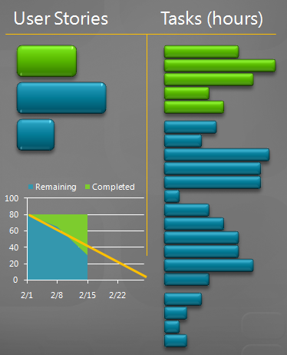
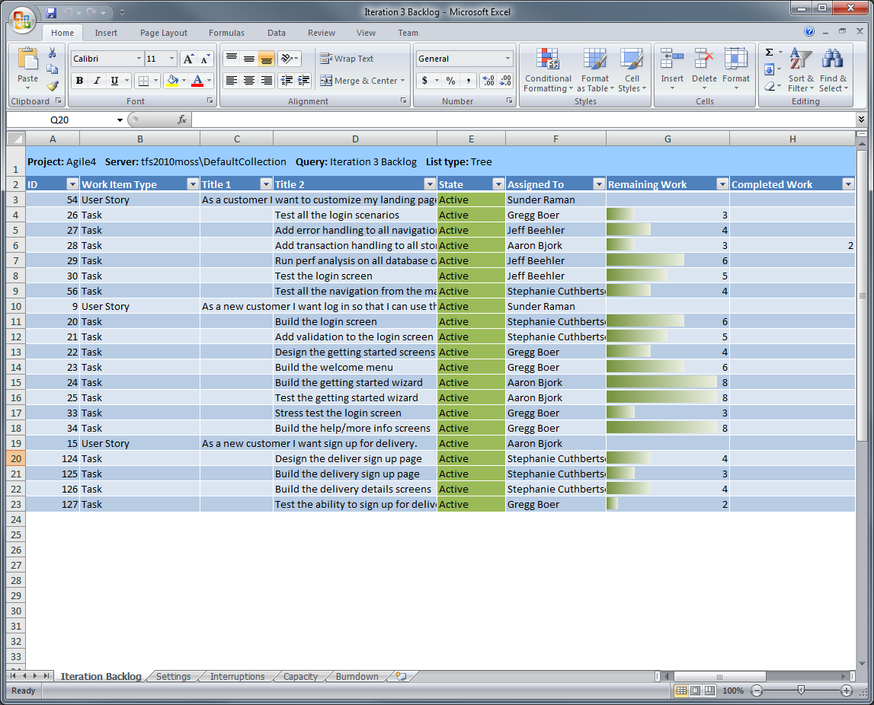
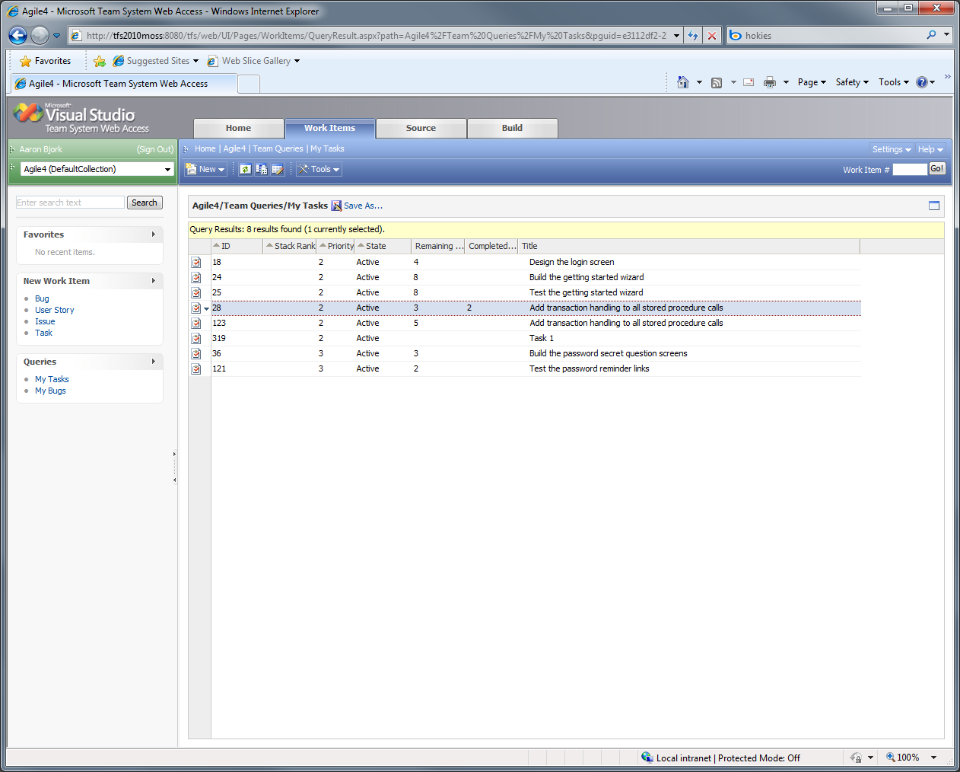
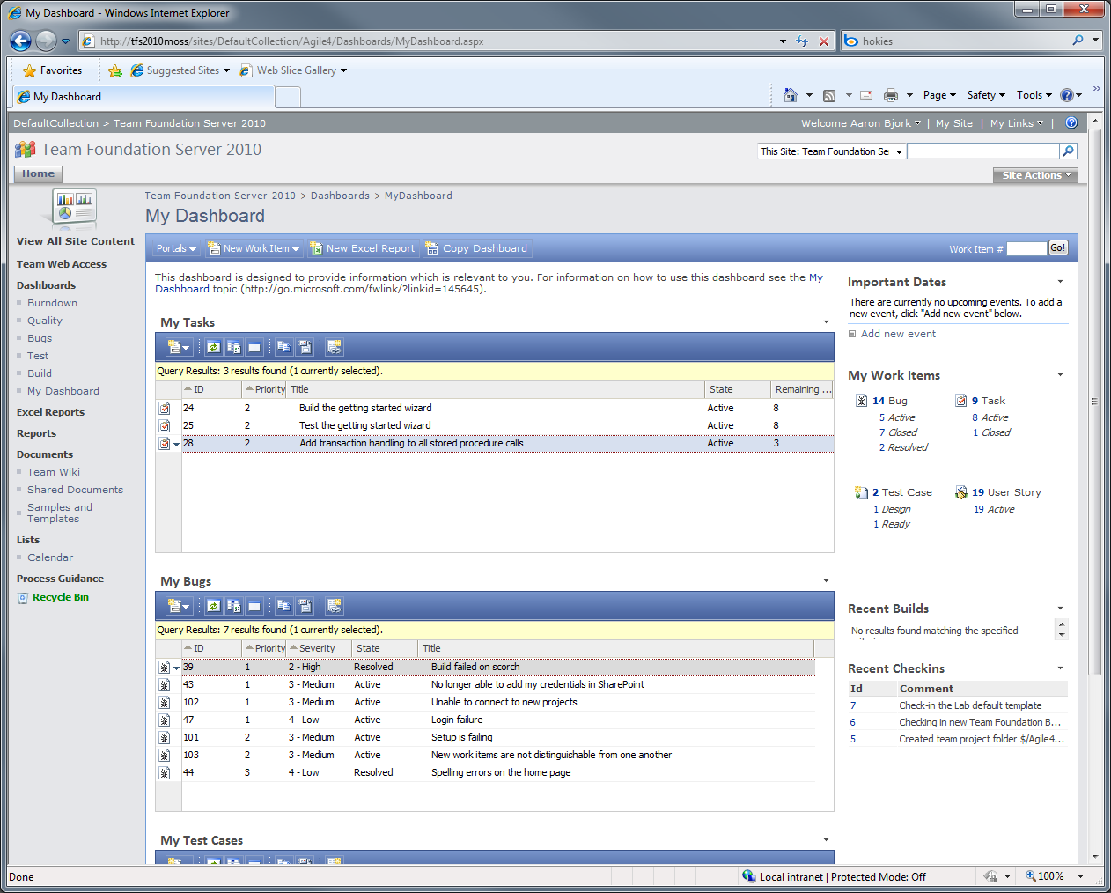
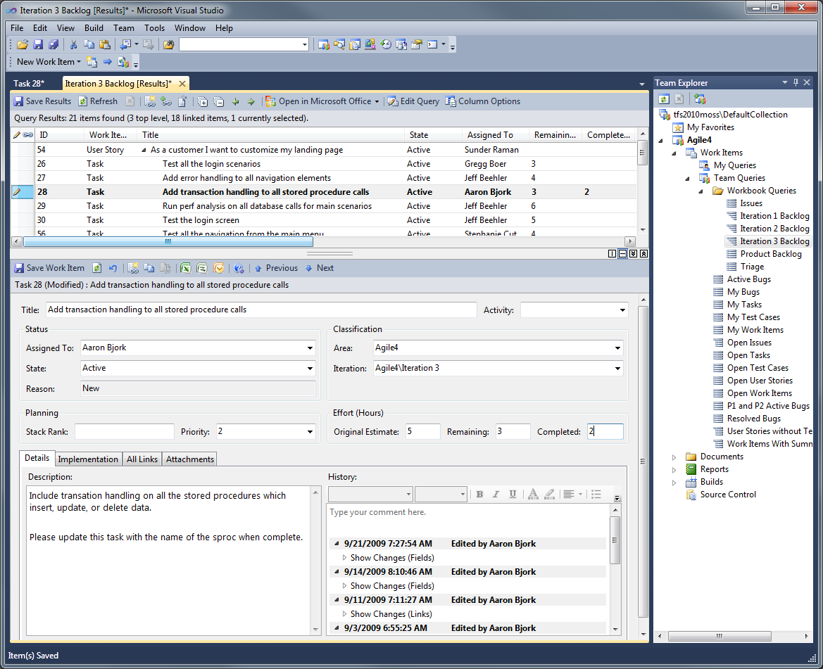
Updating Tasks
Multiple interfaces for updating work items

Slide 9
Updating Tasks
Team Explorer

Slide 10

Updating Tasks
Iteration Backlog workbook

Slide 11
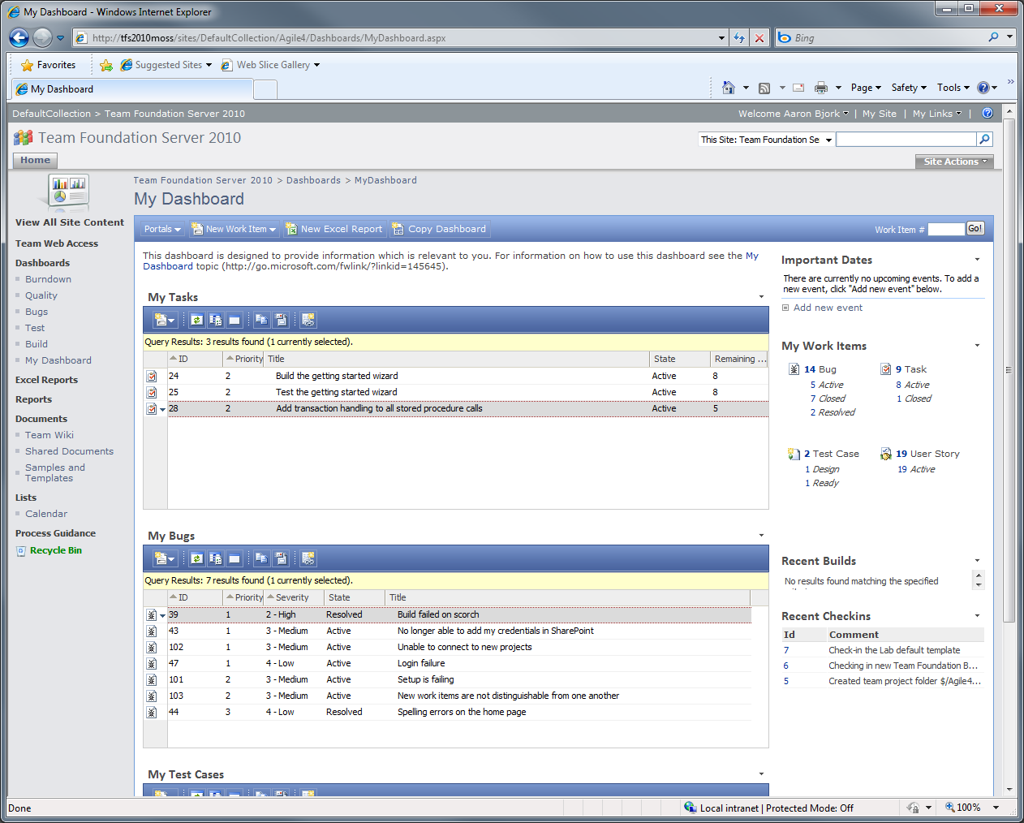
Updating Tasks
Team Project portal

Slide 12
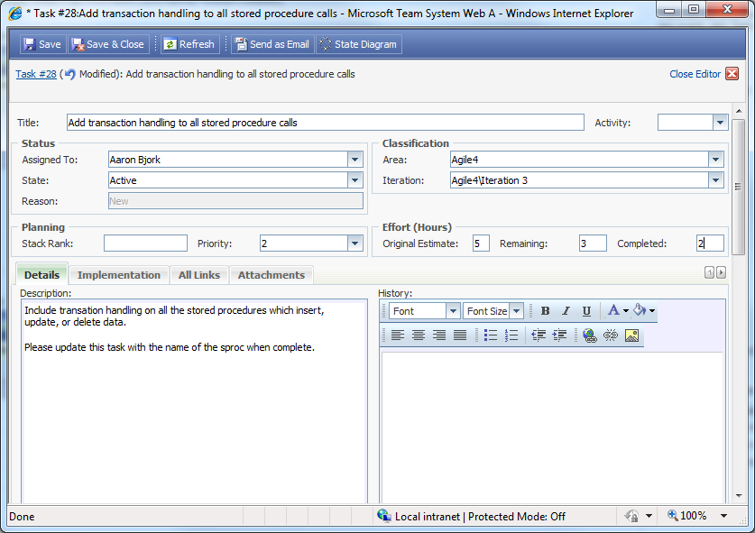
Updating Tasks

Slide 13
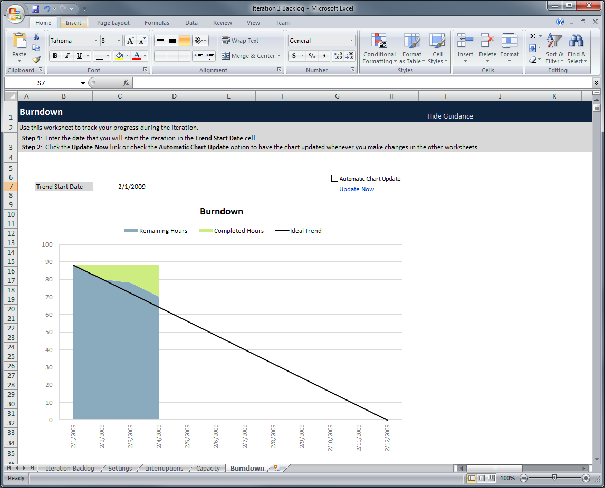
Tracking Progress
Burndown chart tracks remaining and completed work

Slide 14
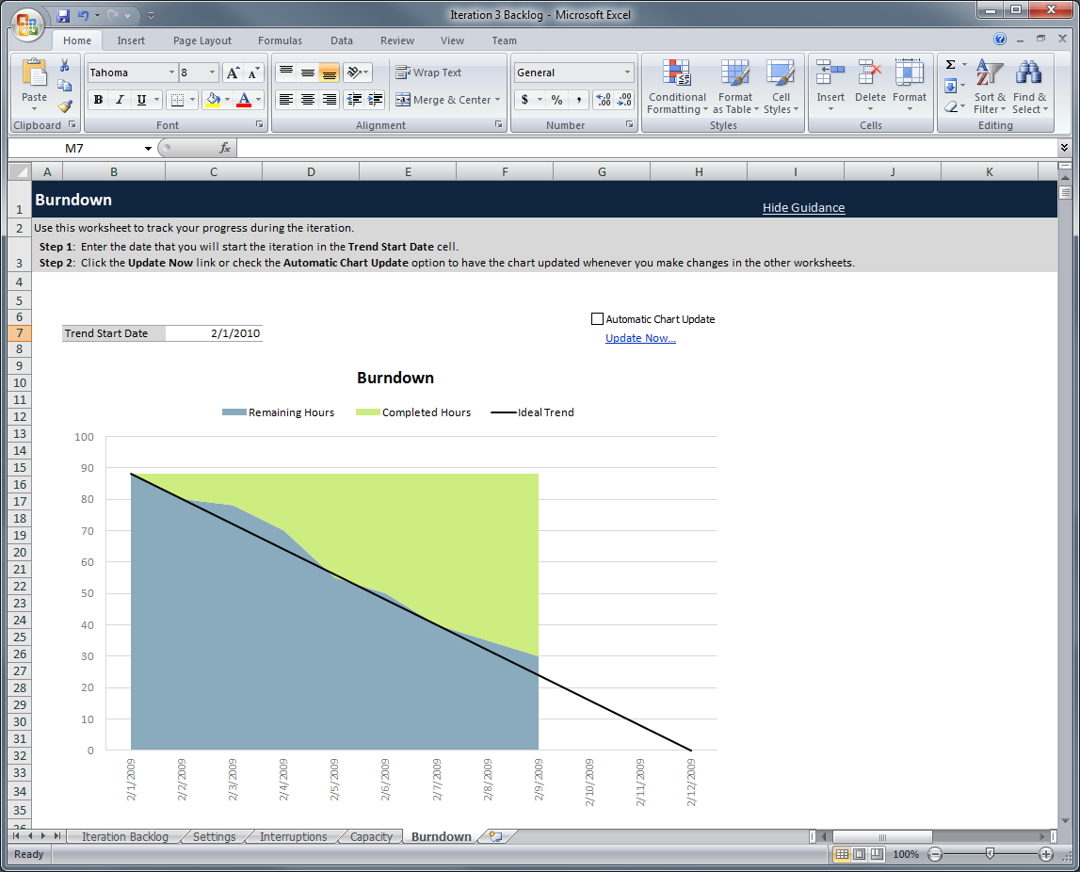
Tracking Progress

Slide 15
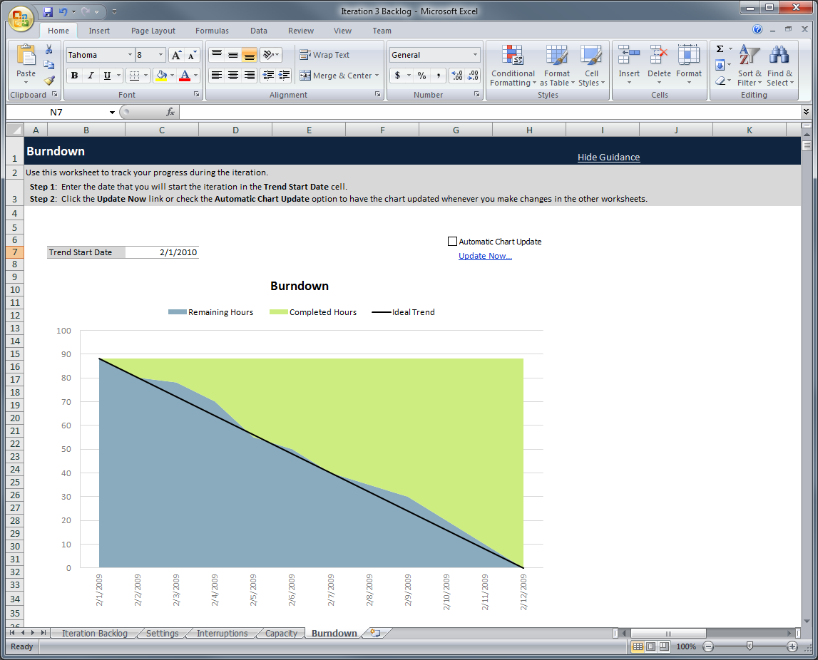
Tracking Progress

Slide 16
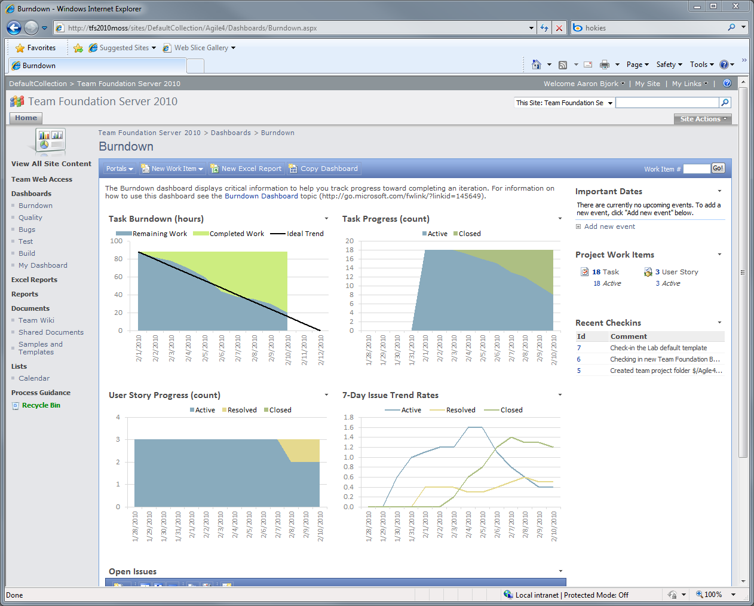
Tracking Progress
Detailed sprint progress is tracked on the project portal
The burndown shows the team on track…
And almost half of the tasks remain open
But the team hasn’t closed any of the three stories…

Slide 17
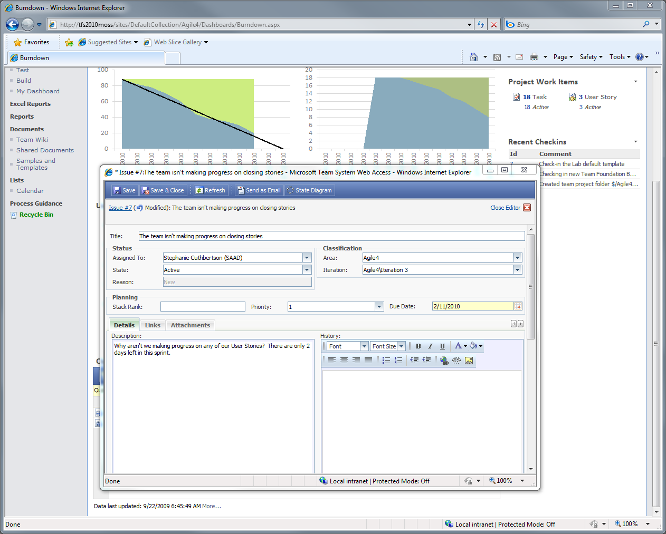
Tracking Progress
The Scrummaster opens an issue to track the problem the portal has identified

Slide 18
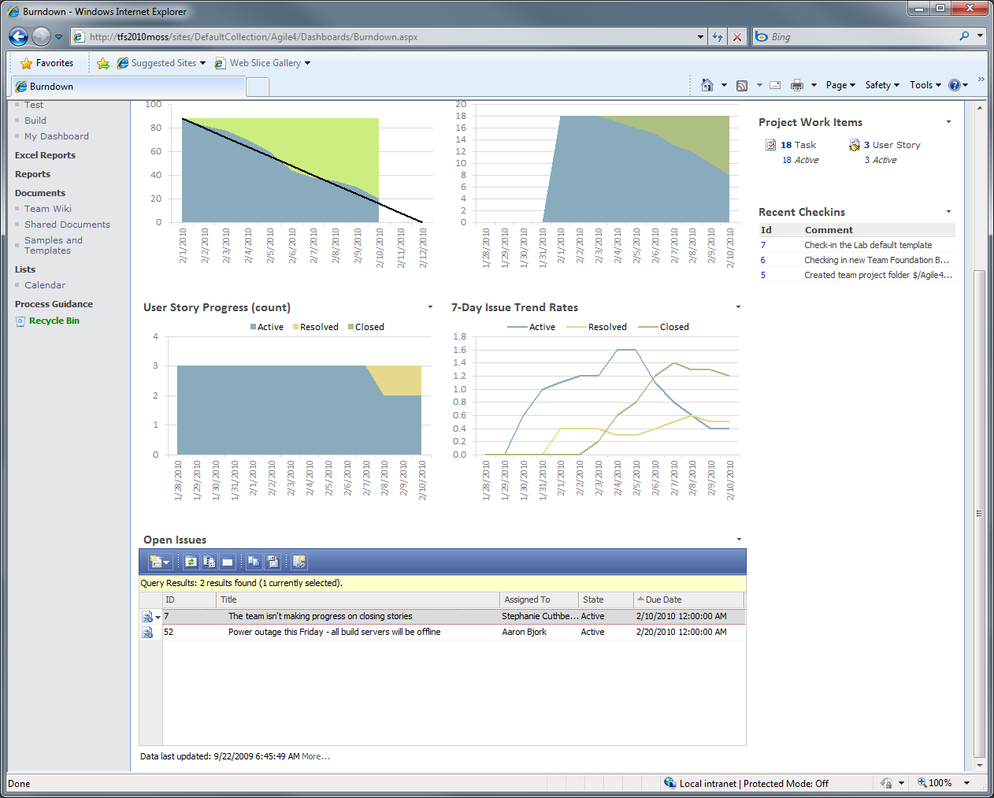
Tracking Progress
The issue is opened and tracked in TFS

Slide 19
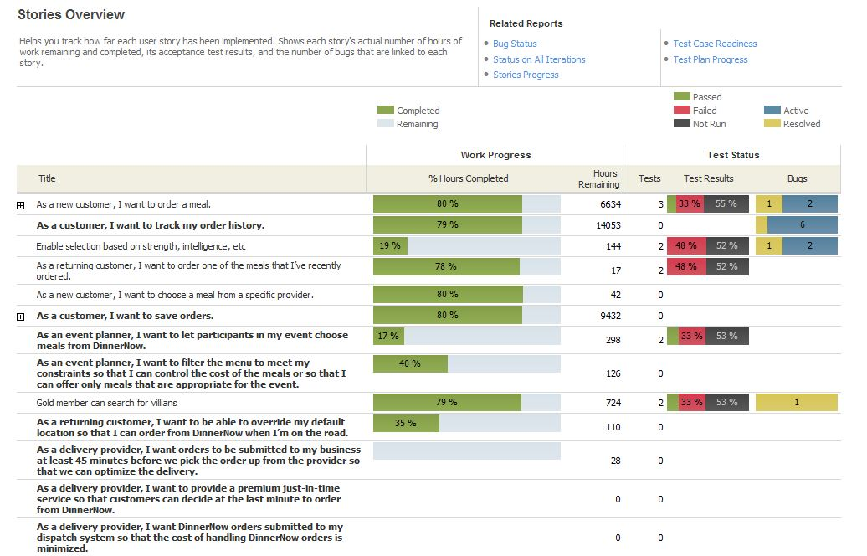
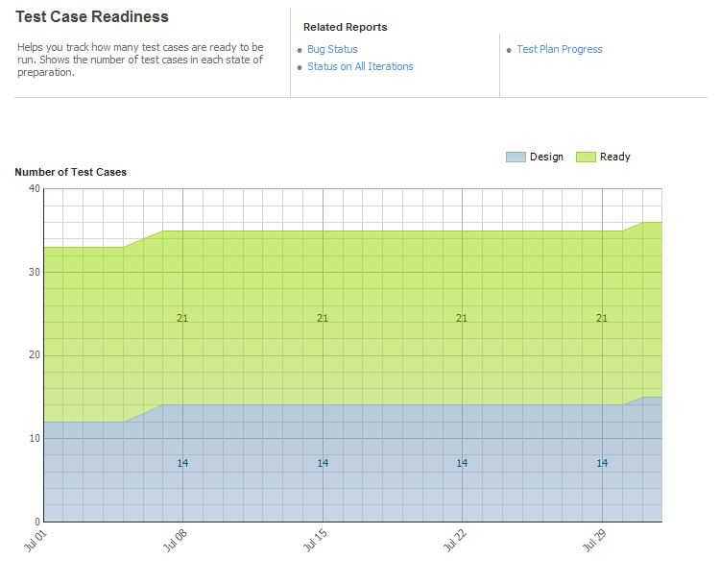
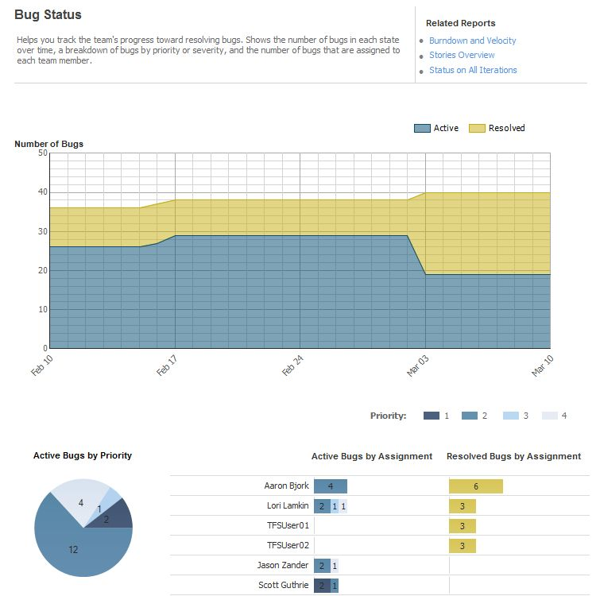
Tracking Progress
Rich set of reports track progress

Slide 20
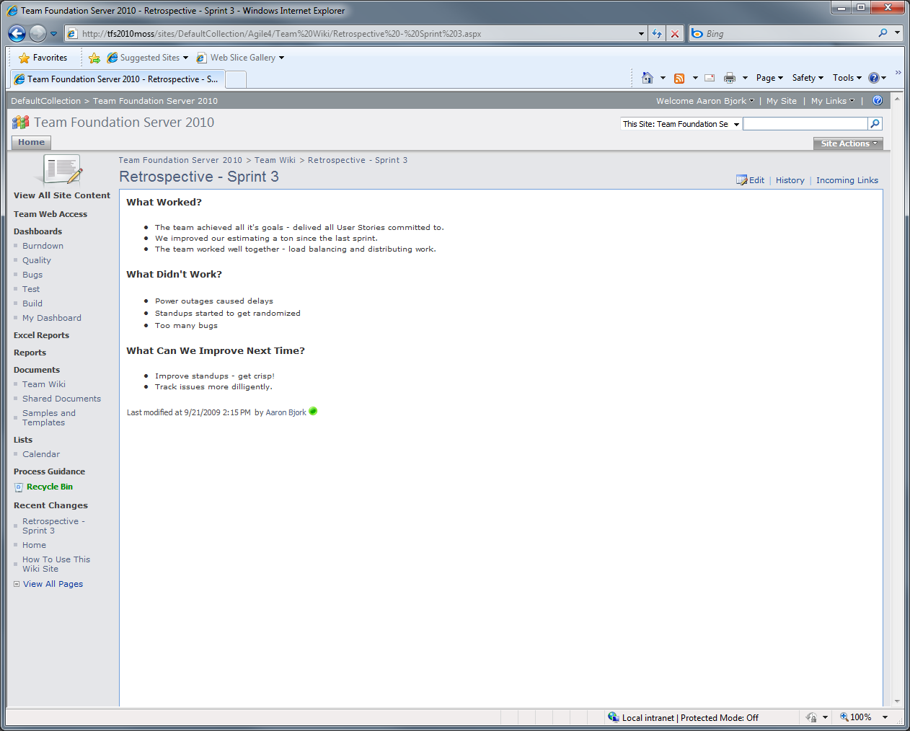
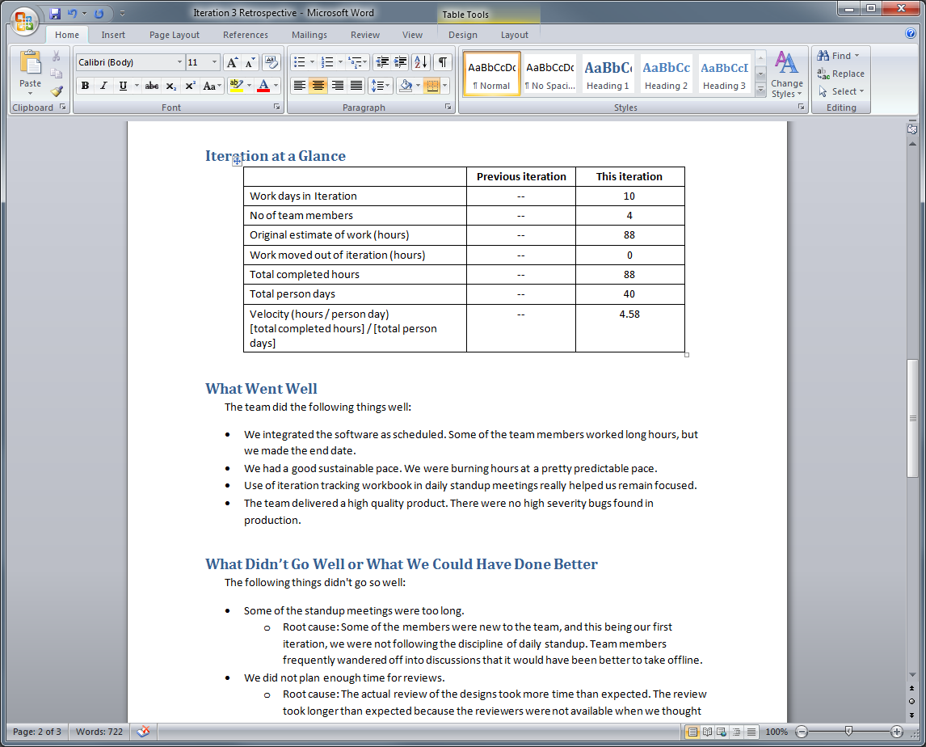
Retrospective
Capture retrospectives using the Team wiki on the Project Portal
Sample documents are provided as a guide

Slide 21
Agenda
Project Management
Scrum Planning (Demo)
Traceability and Link Topology
Excel Reporting (Demo)
Dashboard and Ad Hoc Reporting
New Relational Reporting
What to Use
VS2010

Slide 22
Traceability for MSF Agile 5.0
User Story
Tests/Tested By
Related
Parent/Child
Test
Bug
Task
Code Coverage
Change Sets
Change Sets
Code

Slide 23
Traceability for MSF CMMI 5.0
Change Request
Affects/ Affected By
Requirement
User Story
Tests/Tested By
Related
Parent/Child
Test
Bug
Predecessor/
Successor
Task
Code Coverage
Change Sets
Change Sets
Code

Slide 24

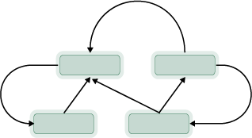


Link Topology Types
Network
Directed Network
Dependency
Tree

Slide 25
Agenda
Project Management
Scrum Planning (Demo)
Traceability and Link Topology
Excel Reporting (Demo)
Dashboard and Ad Hoc Reporting
New Relational Reporting
What to Use
VS2010

Slide 26
Demo
Excel Reporting

Slide 27
Agenda
Project Management
Scrum Planning (Demo)
Traceability and Link Topology
Excel Reporting (Demo)
Dashboard and Ad Hoc Reporting
New Relational Reporting
What to Use
VS2010

Slide 28
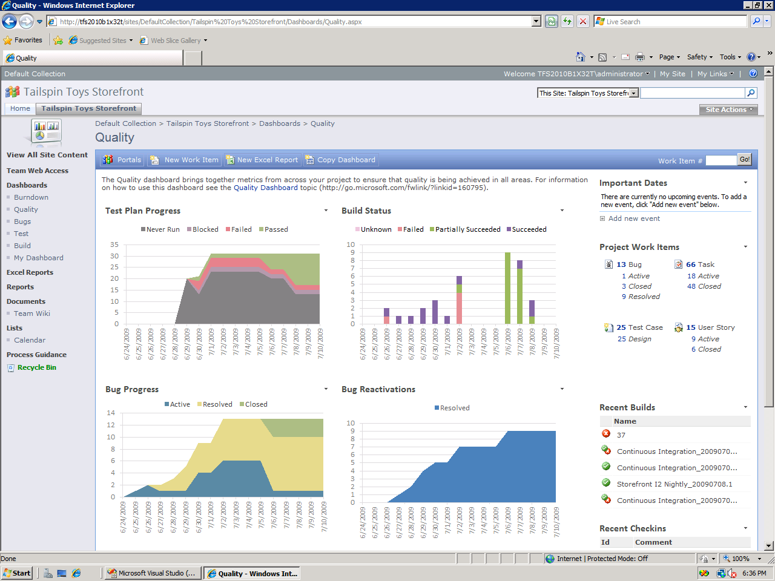
Dashboard: SharePoint Server
Are we making progress on running test plans?
How are our builds doing over time?
Are we fixing bugs?
What’s the quality of our bug fixes?

Slide 29
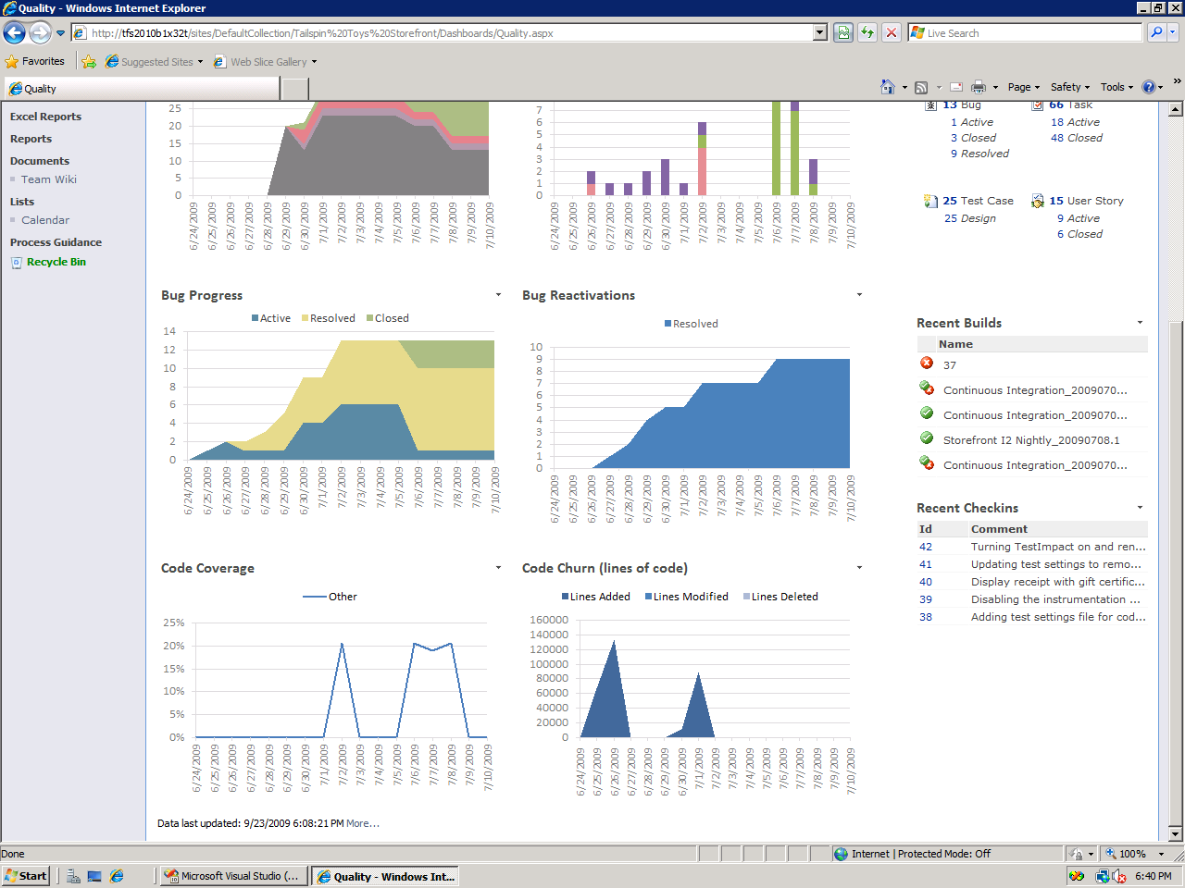
Dashboard: SharePoint Server
Are we getting enough coverage?
How many lines of code are we churning?
Reporting in 2010 | Custom reports | Making transparency work

Slide 30
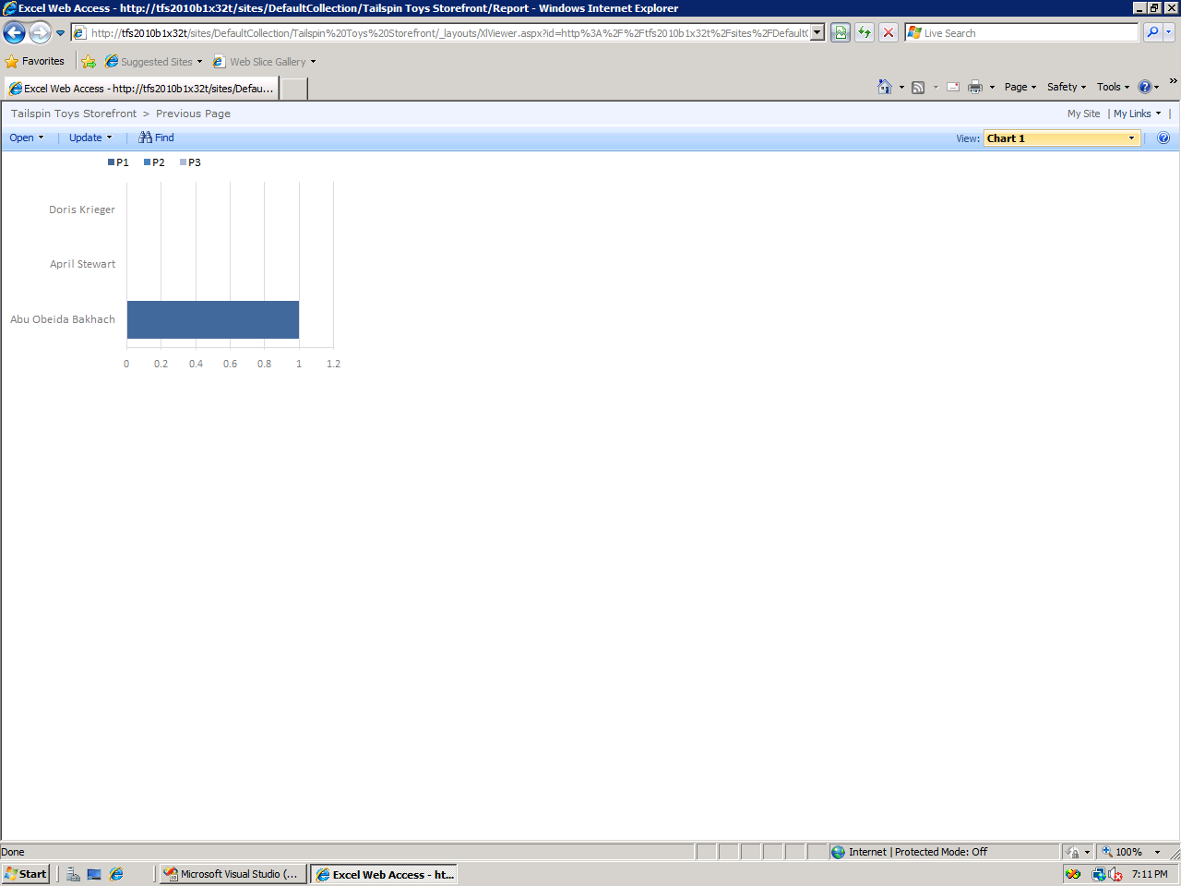
Dashboard: SharePoint Server
Reporting in 2010 | Custom reports | Making transparency work

Slide 31
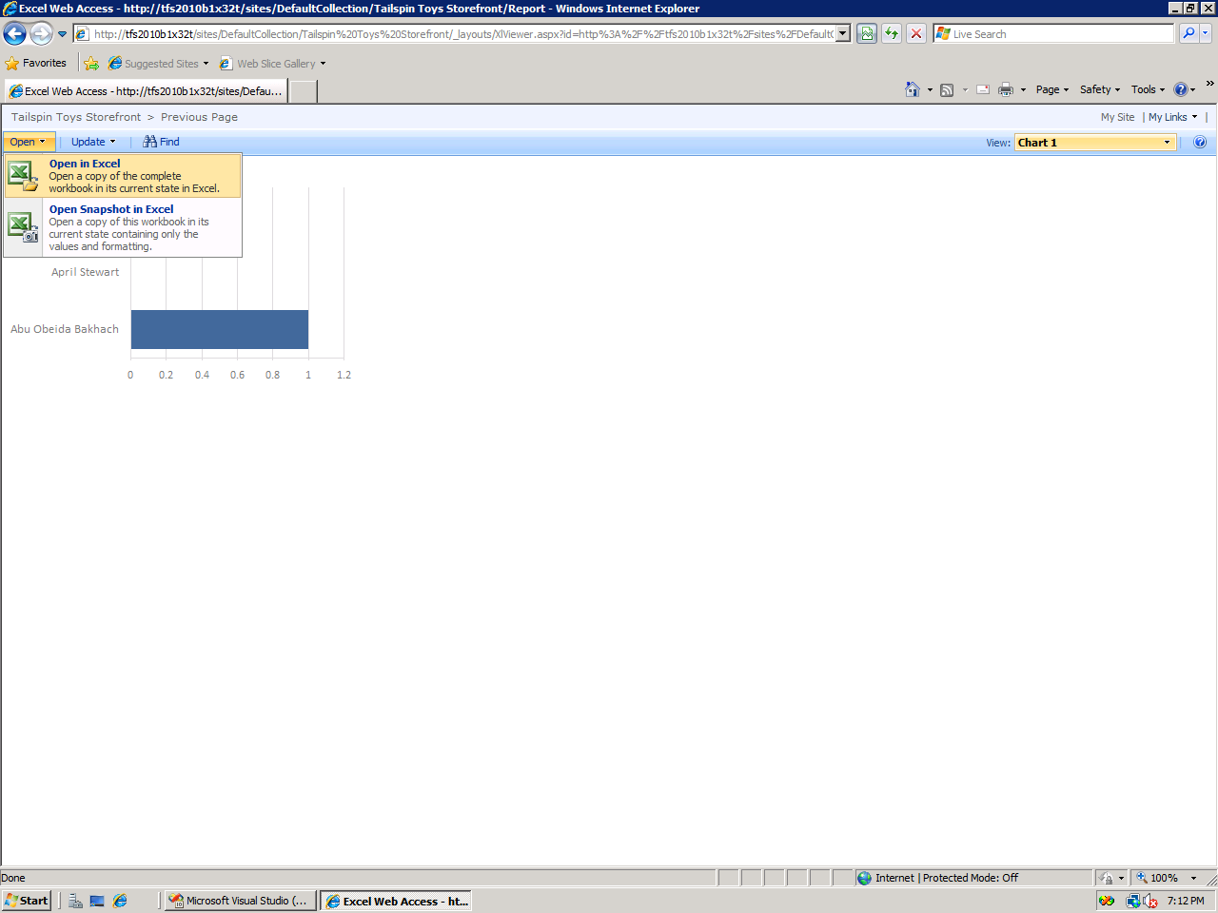
Dashboard: SharePoint Server
Reporting in 2010 | Custom reports | Making transparency work

Slide 32
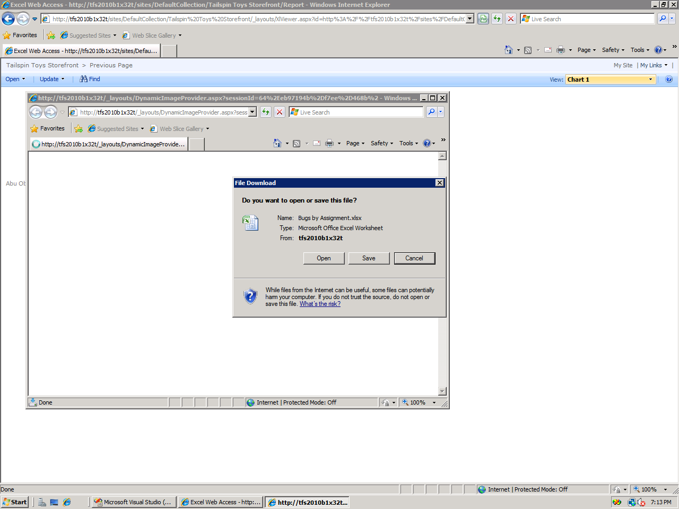
Dashboard: SharePoint Server
Reporting in 2010 | Custom reports | Making transparency work

Slide 33
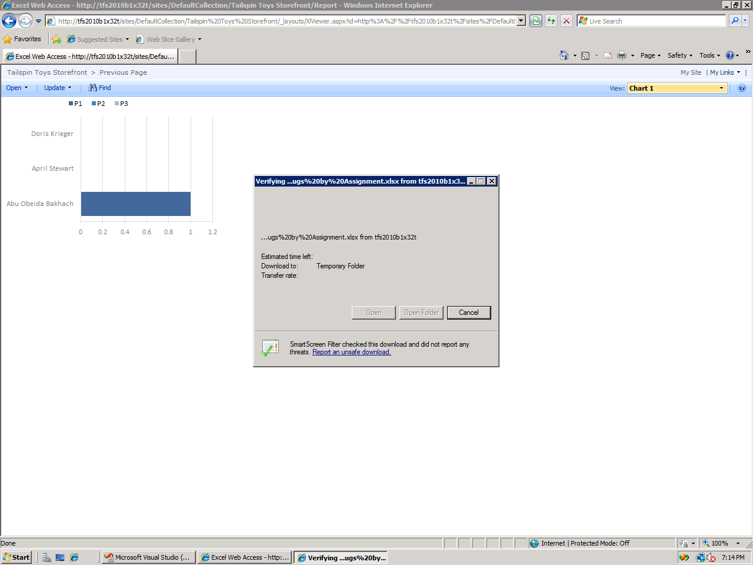
Dashboard: SharePoint Server
Reporting in 2010 | Custom reports | Making transparency work

Slide 34
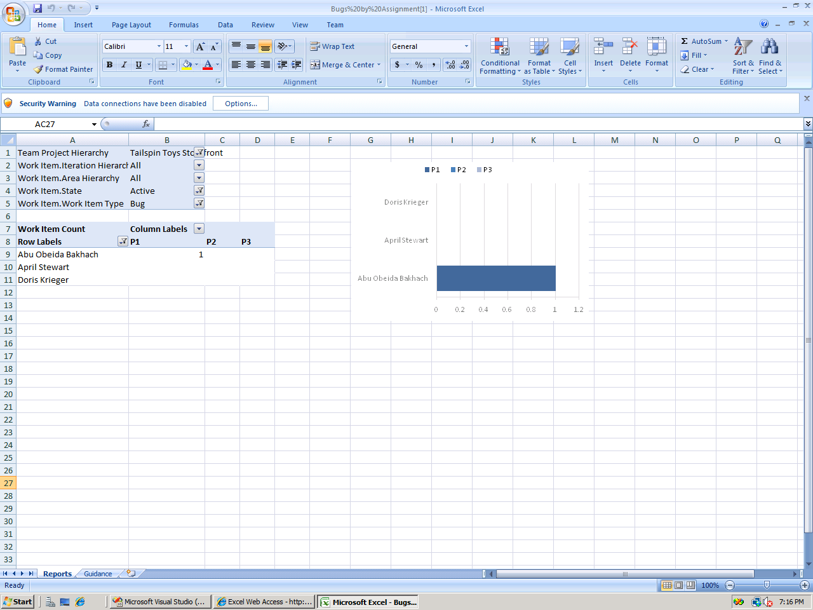
Dashboard: SharePoint Server
Reporting in 2010 | Custom reports | Making transparency work

Slide 35
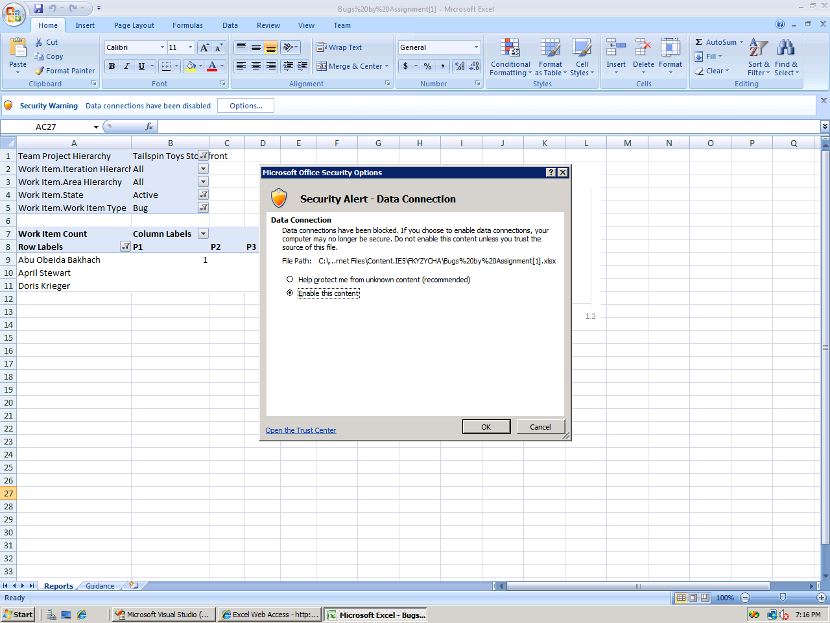
Dashboard: SharePoint Server
Reporting in 2010 | Custom reports | Making transparency work

Slide 36
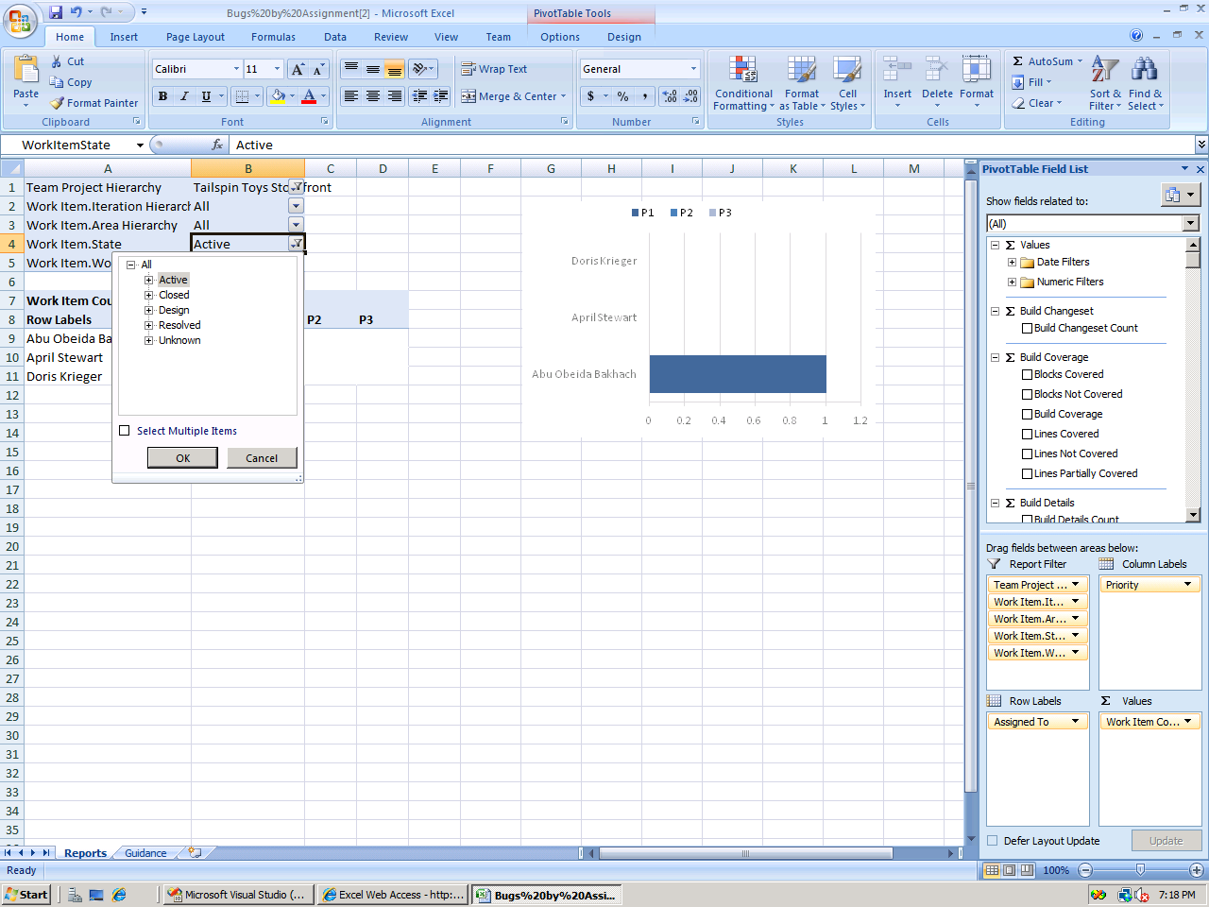
Dashboard: SharePoint Server
Reporting in 2010 | Custom reports | Making transparency work

Slide 37
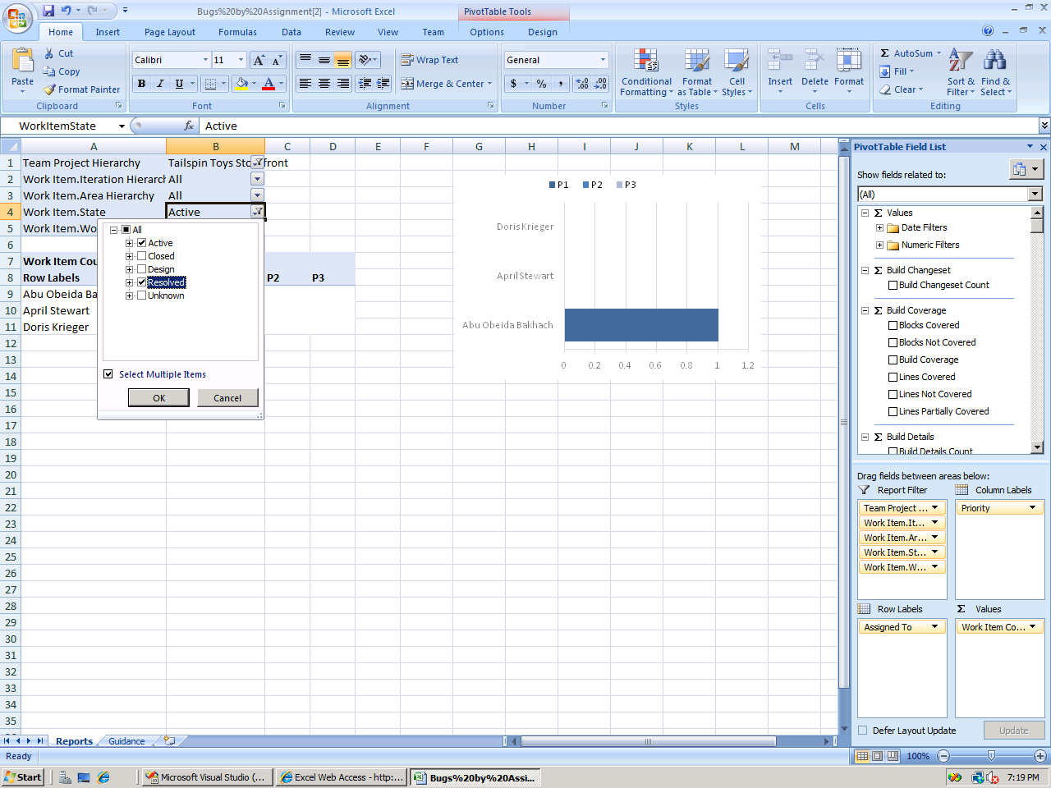
Dashboard: SharePoint Server
Reporting in 2010 | Custom reports | Making transparency work

Slide 38
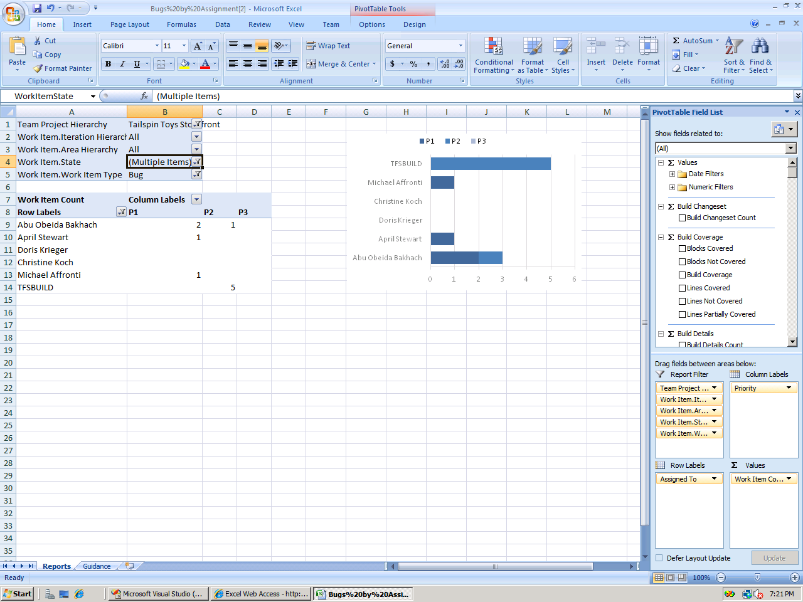
Dashboard: SharePoint Server
Chart now shows Active and Resolved bugs
Reporting in 2010 | Custom reports | Making transparency work

Slide 39
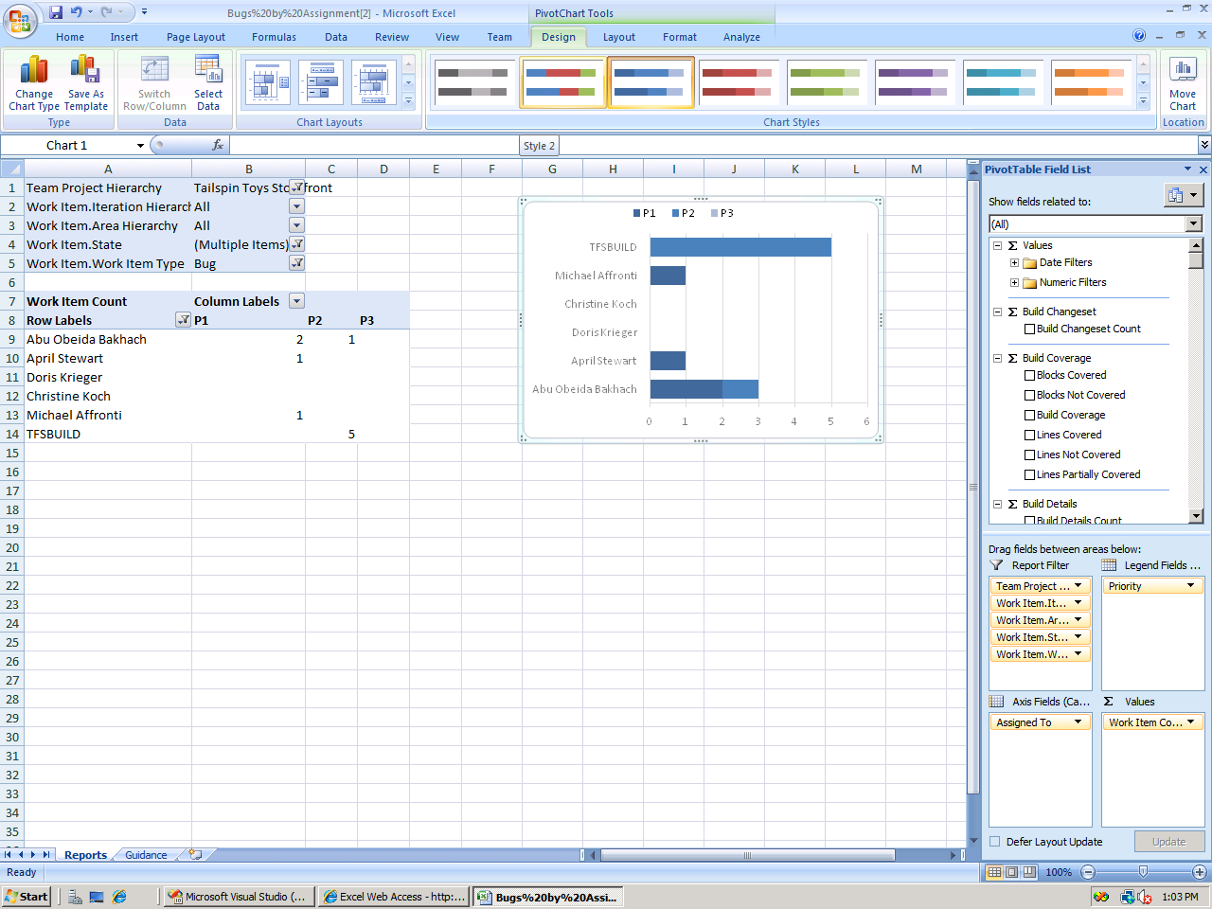
Dashboard: SharePoint Server
Standard Excel chart so properties can easily be modified
Reporting in 2010 | Custom reports | Making transparency work

Slide 40
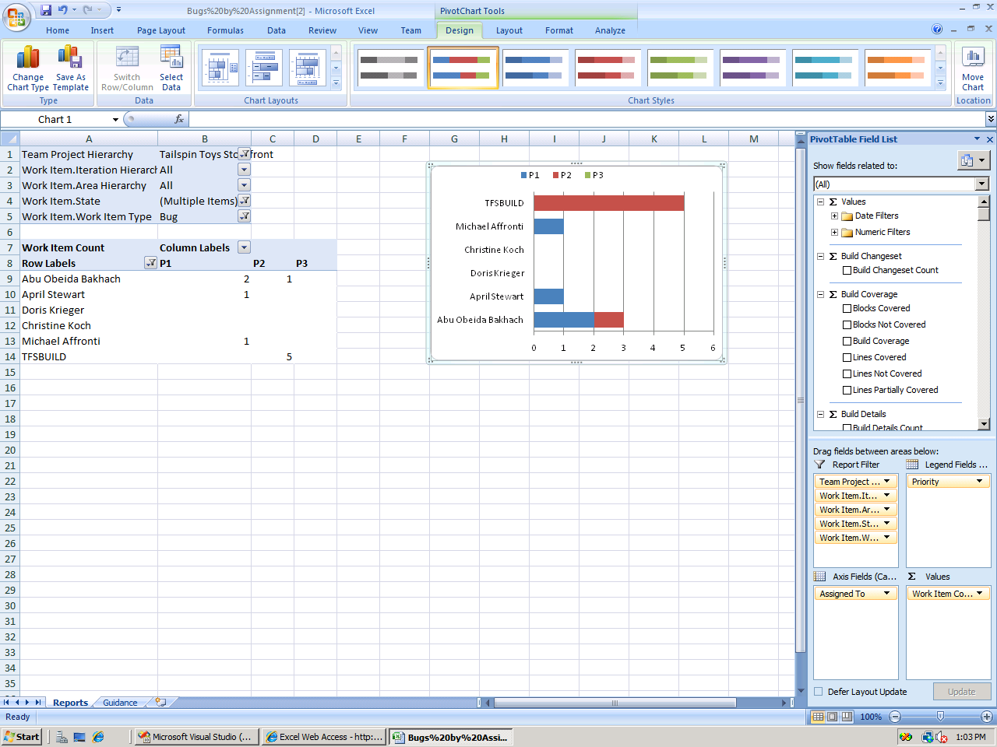
Dashboard: SharePoint Server
Reporting in 2010 | Custom reports | Making transparency work

Slide 41
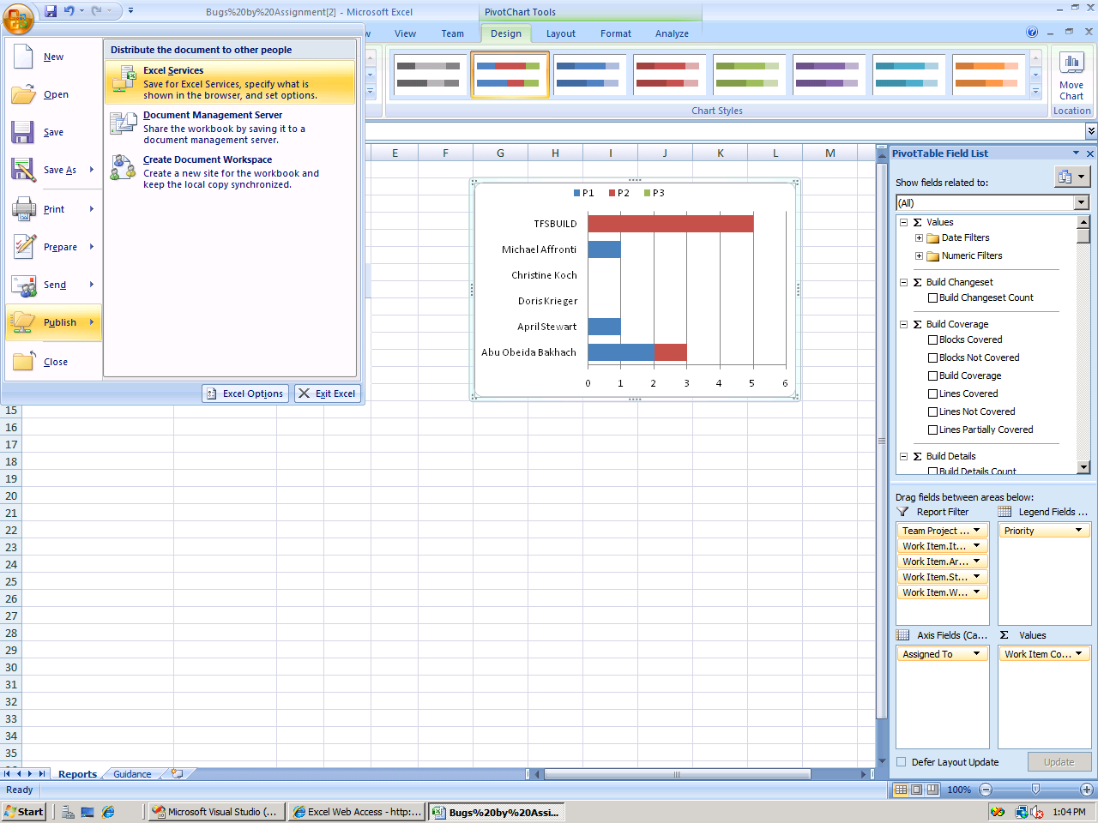
Dashboard: SharePoint Server
I can now publish the updates back to my dashboard
Reporting in 2010 | Custom reports | Making transparency work

Slide 42
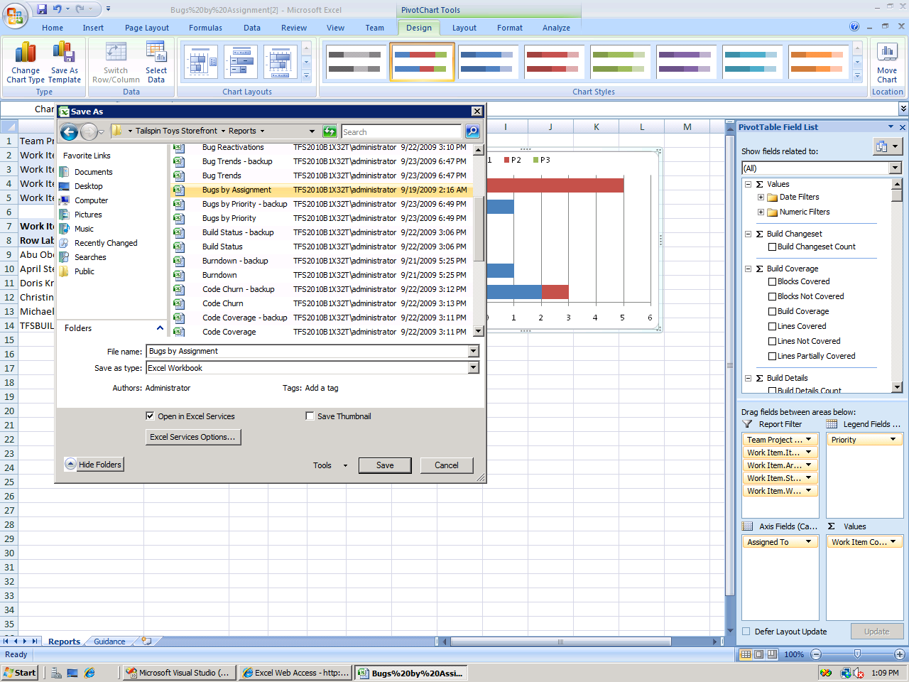
Dashboard: SharePoint Server
Reporting in 2010 | Custom reports | Making transparency work

Slide 43
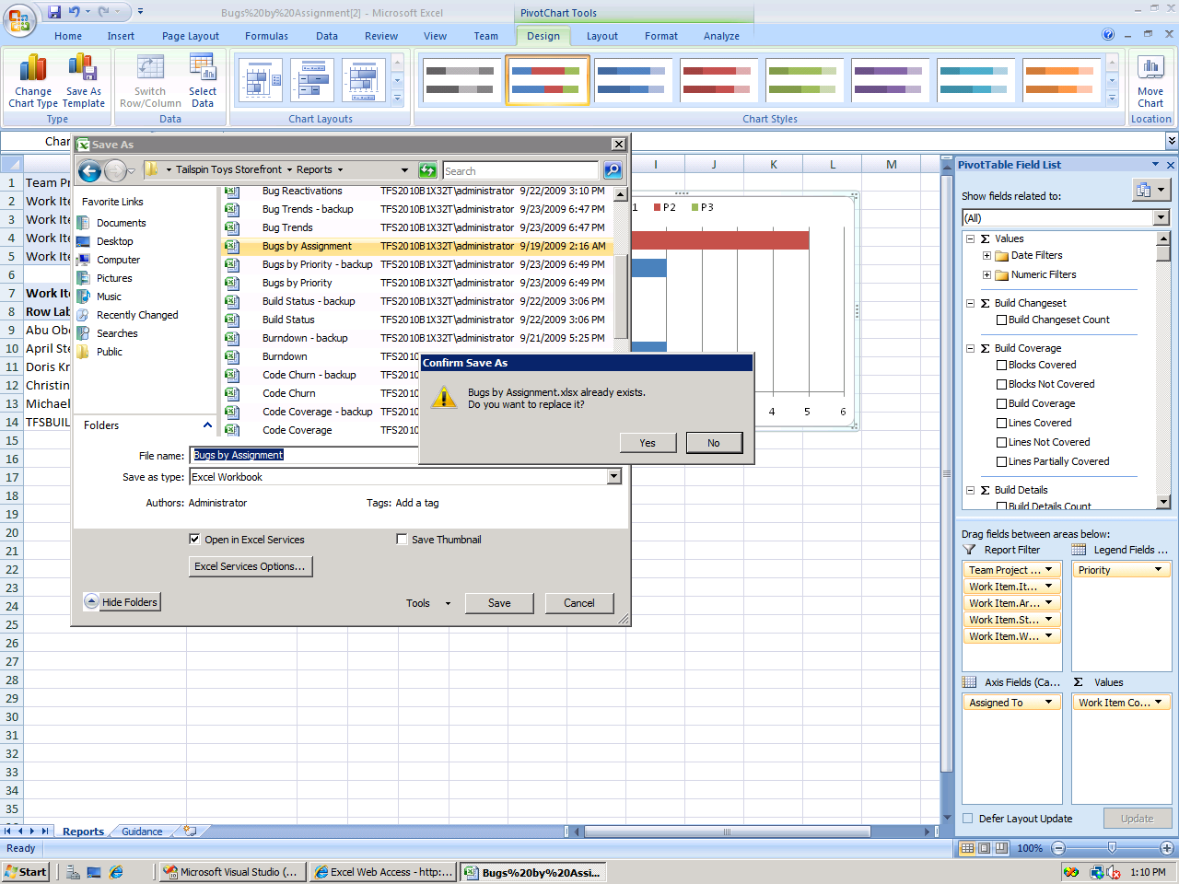
Dashboard: SharePoint Server
Reporting in 2010 | Custom reports | Making transparency work

Slide 44
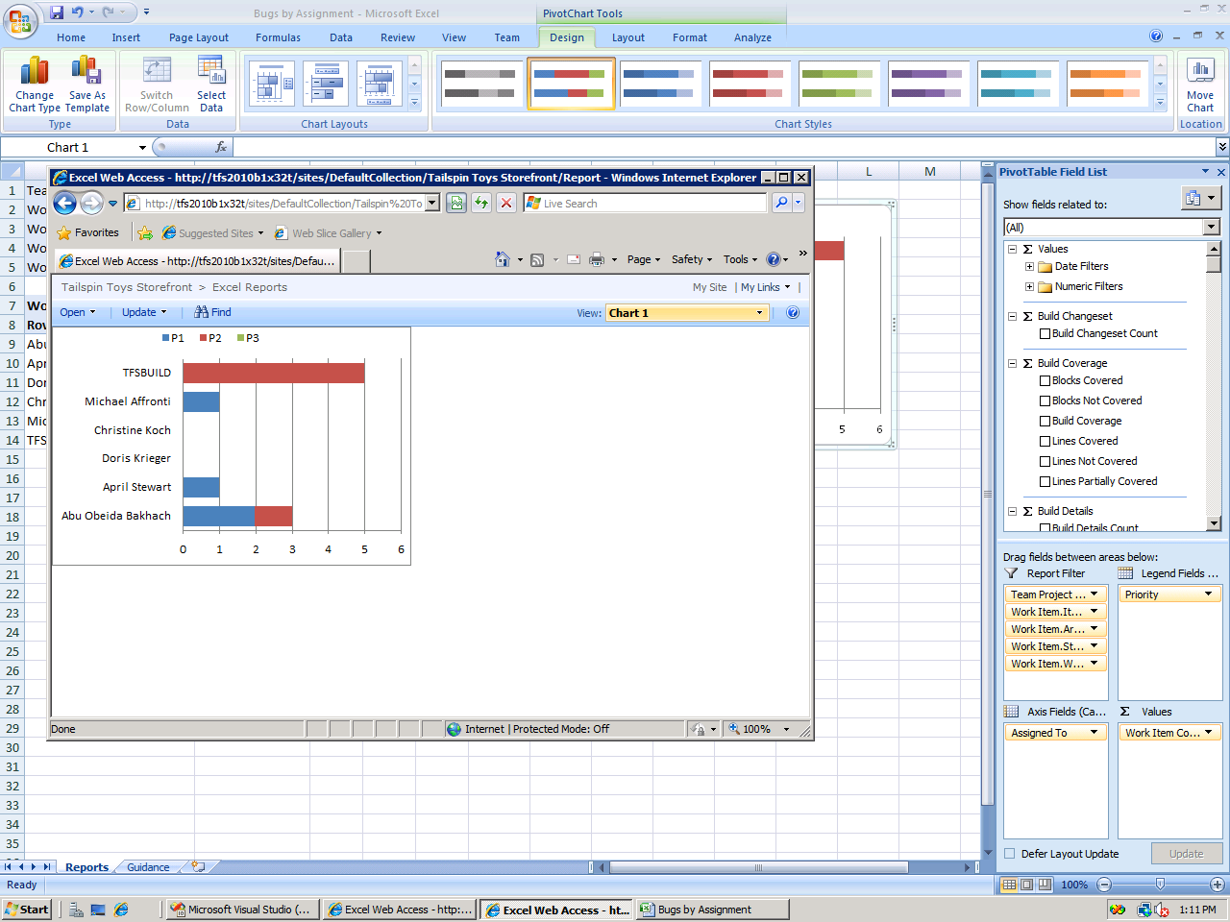
Dashboard: SharePoint Server
Reporting in 2010 | Custom reports | Making transparency work

Slide 45
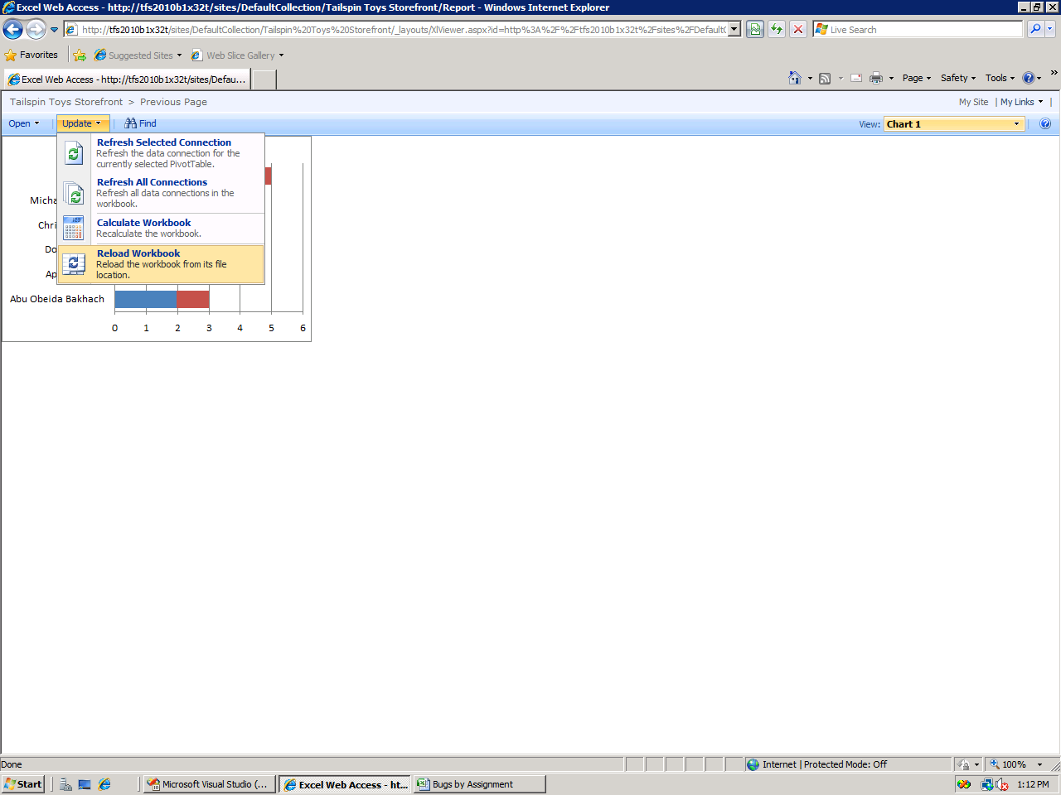
Dashboard: SharePoint Server
Reload the workbook to clear Excel Services cache so that the updates show up immediately
Reporting in 2010 | Custom reports | Making transparency work

Slide 46
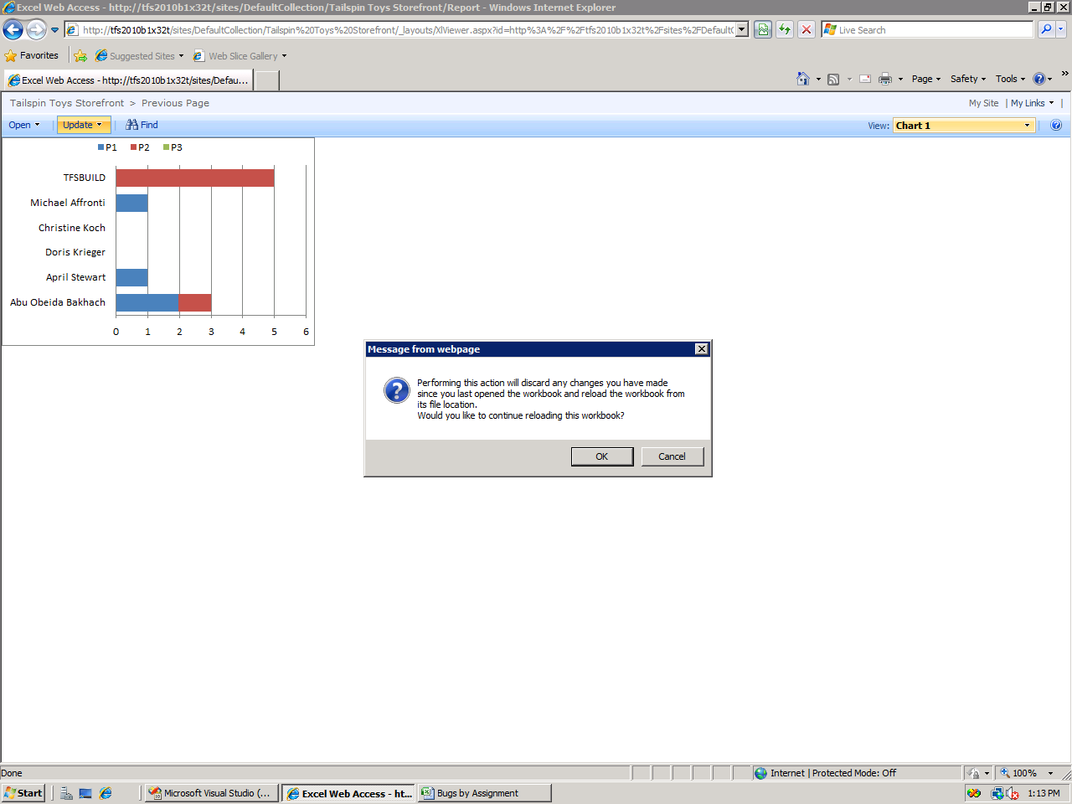
Dashboard: SharePoint Server
Reporting in 2010 | Custom reports | Making transparency work

Slide 47
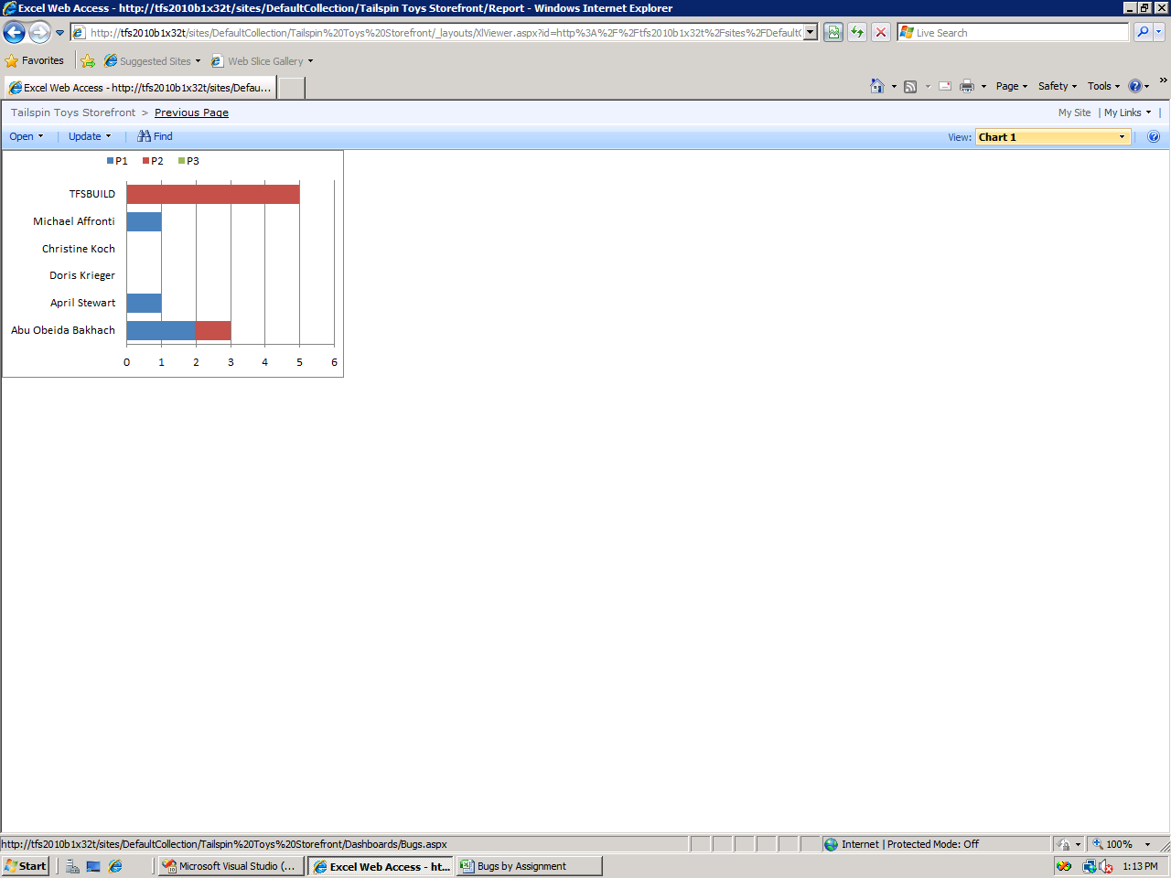
Dashboard: SharePoint Server
Reporting in 2010 | Custom reports | Making transparency work

Slide 48
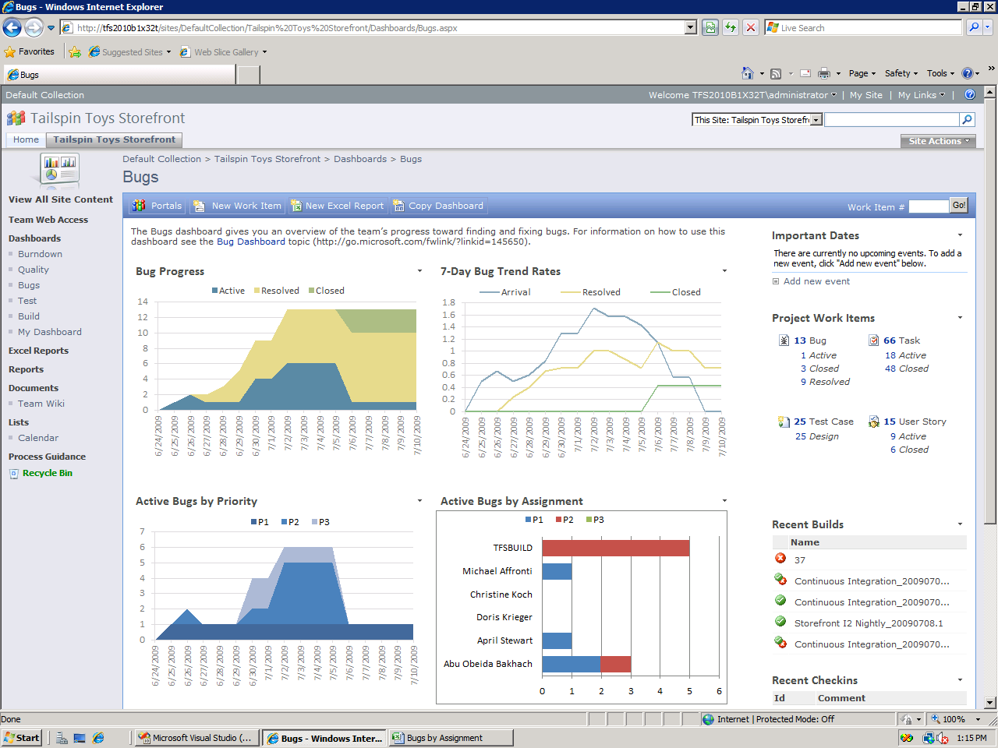
Dashboard: SharePoint Server
My dashboard shows active and resolved bugs now - that was easy!
Reporting in 2010 | Custom reports | Making transparency work

Slide 49
Agenda
Project Management
Scrum Planning (Demo)
Traceability and Link Topology
Excel Reporting (Demo)
Dashboard and Ad Hoc Reporting
New Relational Reporting
What to Use
VS2010

Slide 50
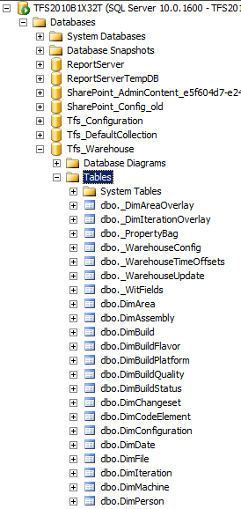
Relational Reporting
Reporting against relational warehouse is supported!
… instead of this
-- MDX --
SELECT
{
[Measures].[DateValue],
[Measures].[Work Item Count]
} ON COLUMNS,
{
CrossJoin(
[Date Range],
[Work Item].[System_State].[System_State]
)
} ON ROWS
FROM
(
SELECT
CrossJoin(
StrToSet(@AreaParam),
StrToSet(@IterationParam),
StrToSet(@StateParam),
StrToSet(@PriorityParam),
StrToSet(@SeverityParam)
) ON COLUMNS
FROM [Team System]
)
Write this…
-- SQL--
SELECT history.[System_Id] AS ID, MAX(history.[System_ChangedDate]) AS Latest
FROM @Hierarchy hierarchy INNER JOIN [WorkItemHistoryView] history ON hierarchy.ID = history.[System_Id]
WHERE (history.[System_ChangedDate]&lt; @ChangeDate)
GROUP BY history.[System_Id]

Slide 51
Relational Reporting
What’s supported?
Tables in the warehouse database that have names that don’t start with ‘_’ E.g. DimWorkItem.
There are a set of helper views – view names that don’t start with ‘v’ E.g. CurrentWorkItemView.
All Table-Valued Functions
What’s not?
Tables starting with ‘_’ and views starting with ‘v’ are only for system use i.e. subject to change in future release

Slide 52
Agenda
Project Management
Scrum Planning (Demo)
Traceability and Link Topology
Excel Reporting (Demo)
Dashboard and Ad Hoc Reporting
New Relational Reporting
What to Use
VS2010

Slide 53



Tools and reports
Business Intelligence Development Studio (BIDS)
Complex RS report
Power
Report
Builder
RS report for sharing with team on SharePoint Foundation dashboard
Upload to team project reporting site that you can subscribe to
Excel
Sharing chart in an email
Shared with team on SharePoint Server dashboard
Learning curve

Slide 54
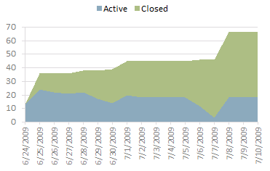
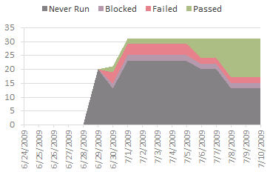
What kind of reports can I build using these tools?
Individual current or trend charts
Excel

Slide 55
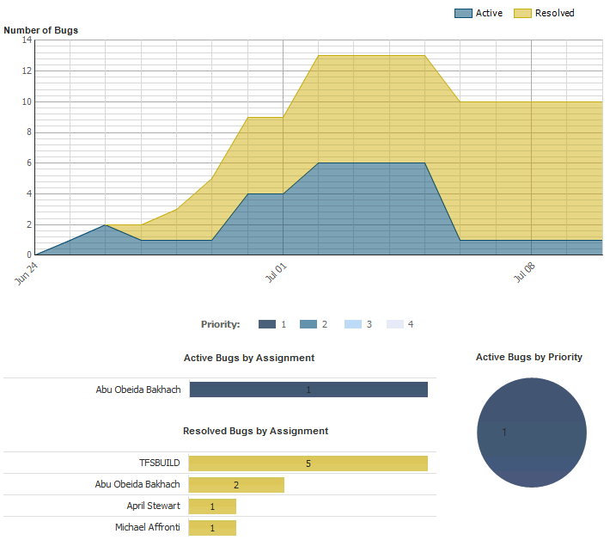
What kind of reports can I build using these tools?
Multiple charts showing data in a single RS report
Report
Builder

Slide 56
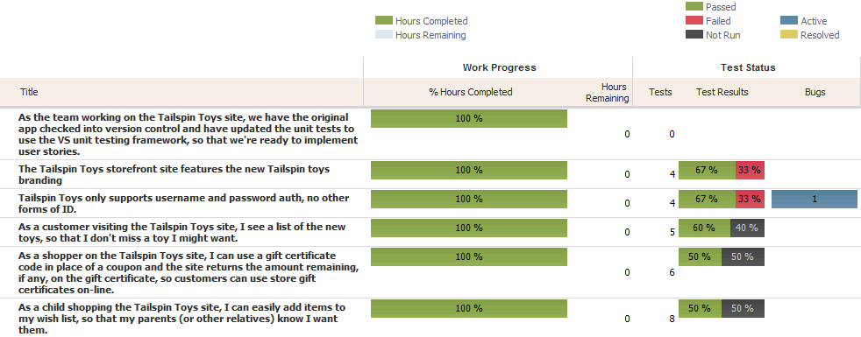
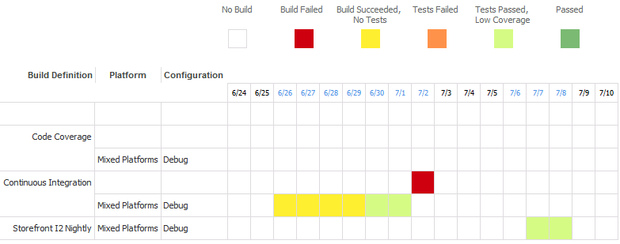
What kind of reports can I build using these tools?
Business Intelligence Development Studio (BIDS)
Complex RS reports with custom visualization

Slide 57
Reporting Out of the Box - Summary
Dashboards
Sharepoint WSS
Sharepoint Office Server System
Reports
Create Excel Report from Query
Ad-Hoc Excel Reporting
SQL Report Designer
SQL BI Studio
Data Availability
Data Warehouse (MDX, Excel Reporting)
Relational Warehouse (SQL)
Extensibility Layer to Import External Data into Warehouse

Slide 58
Agenda
Project Management
Scrum Planning (Demo)
Traceability and Link Topology
Excel Reporting (Demo)
Dashboard and Ad Hoc Reporting
New Relational Reporting
What to Use
VS2010

Slide 59




Visual Studio 2010
Notes:
With the release of Visual Studio 2010 we are moving to a nested-model, with three variations – good, better and best.
[CLICK]
First we have Good – Visual Studio 2010 Professional with or without MSDN. Visual Studio 2010 Professional is the essential tool for basic development tasks to assist developers in implementing their ideas easily. This is the newest release of the Professional-level with added capabilities for SharePoint and Cloud development, among others.
[CLICK]
Next, we add on to all of the capabilities in Professional with Visual Studio 2010 Premium with MSDN. The Premium-level is a complete toolset for developers to deliver scalable, high quality applications, and introduces capabilities previously associated with our Visual Studio Team System products, including offline database development and static code analysis, as well as new capabilities including Test Impact Analysis and Coded UI Testing.
[CLICK]
And at the top of the stack is Visual Studio 2010 Ultimate. This product is the comprehensive suite of application lifecycle management tools for teams to ensure quality results from design to deployment. With Ultimate, you get everything – IntelliTrace (the new historical debugger), architecture tools, testing tools, and everything in Premium and Professional.
[CLICK]

Slide 60





Test Manager 2010
IntelliTrace™
Test Case Management
UML Modeling
Manual Testing
Architecture Explorer
Fast Forward for Manual Testing
Logical Class Designer
Layer Diagram
Load Testing
Web Testing
UI Test Automation
Test Impact Analysis
Performance Profiling
Static Code Analysis
Code Coverage
Code Metrics
Database Change Mgmt
Database Deployment
Database Unit Testing
Test Data Generation
Silverlight Tools
Multi-core Development
SharePoint Development
Cloud Development
Web Development
Windows Development
Generate from Usage
Office Development
New WPF Editor
Customizable IDE
Notes:
Let me drill down into the capabilities in each product. For a more extensive list of capabilities, please go to www.microsoft.com.vstudio.
Microsoft Visual Studio 2010 Professional is the essential tool for basic development tasks to allow developers to implement their ideas easily. This includes core capabilities for Windows, Web, and Office development, along with new capabilities for Cloud and SharePoint development. There are also new tools for Silverlight and Multi-core development. With Visual Studio 2010 the IDE and editor were refreshed using Microsoft Windows Presentation Foundation.
[CLICK]
Microsoft Visual Studio 2010 Premium is a complete toolset for developers to deliver scalable, high quality applications. This includes support for offline database development, unit testing and change management, static code analysis, performance profiling and code coverage and code metrics. New capabilities including UI test automation (aka Coded UI Tests) and Test Impact Analysis are available in premium.
[CLICK]
Microsoft Visual Studio 2010 Ultimate is the comprehensive suite of application lifecycle management tools for teams to ensure quality results from design to deployment. This includes IntelliTrace – the new historical debugger which enables debugging events that ran previously on your machine, or another machine. Microsoft Test Manager 2010 is included in Ultimate enabling complete Test Case Management and test execution. Additionally the new architecture and modeling tools are included in Ultimate, including support for authoring UML diagrams (Activity, Use Case, Sequence, Component and Class diagrams are supported).
[CLICK]

Slide 61
Test Manager 2010
Test Case Management
Manual Testing
Team Explorer
Fast Forward for Manual Testing
Lab Mgmt Config.
Team Agents
Virtual Env. Setup/Tear Down
Environment from Template
Checkpoint Environment
Version Control
Gated Check-in
Reporting
Build Automation
Branch Visualization
Test Case Management
Agile Planning Tools
Team Portal
Notes:
There are some additional products in the Visual Studio 2010 family.
Team Foundation Server 2010 is the center of gravity – the hub for a development team. Team Foundation Server has a version control repository, a test case management database, a work item tracking and change management system, support of build automation and a comprehensive reporting solution built on SQL Server Reporting Services. Some of the new capabilities of Team Foundation Server include support for gated check-in, branch visualization and drag-n-drop merge, and new Agile Planning tools.
[CLICK]
Lab Management 2010 enables teams to configure and manage virtual lab environment. Lab Management works with System Center Virtual Machine Manage enabling teams to create environment templates, provision ring-fenced environments, and checkpoint those environments. Those checkpoints can be attached to bugs filed using the Test Manager 2010 enabling the person fixing the bug to open the environment right to the appropriate point in the application flow.
[CLICK]
Visual Studio Test Professional 2010 is the essential tool for anyone engaging in test case management or manual test execution in the development lifecycle. This tool is designed for the generalist tester – someone who tests applications, but who is not responsible for writing code. This product includes Microsoft Test Manager 2010 (the Visual Studio IDE is not included).
[CLICK]

Slide 62
Q& A

Slide 63
References
Brian Harry’s Presentation in Teched Europe about Lap around VS2010 Project Management
Stephanie Saad Cuthbertson Presentation in Teched Europe About Planning and Tracking

